Slide 1

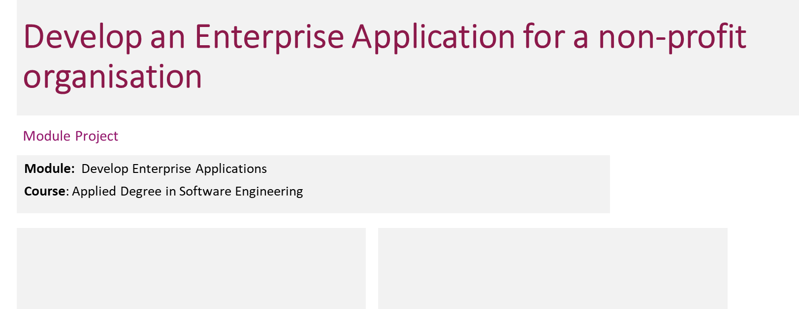
Develop Enterprise Application
Learner Name : Wildan Luqmanul Hakim
Enrollment ID : BDSE0322
Presentation Date :
Start Date : January 13, 2023
End Date : February 06, 2023
Submission Date : February 07, 2023

Slide 2

Contents
S/N | TOPIC
1 | Project Definition
2 | Project Deliverables
3 | Project Milestones & Tasks
4 | Project Environment
5 | Tools
6 | Project Design
7 | Gantt Chart
8 | Project Execution

Slide 3
Project Definition
Our team was tasked by a company named MerryMeal to submit proposals for software development. The proposal includes design suggestions, development plans, functional application, and developing the application based on the company business plan.
The company “MarryMeal” is a charitable organization that prepares and delivers a hot noon meal to qualified adults living at home who are unable to cook for themselves or maintain their nutritional status due to age, disease, or disability. The service will be available Monday through Friday. Frozen meals will be provided to members who are not within a 10-kilometer radius of their outsourced kitchens and support over the weekend. MerryMeal has partnered with several food service providers across the country to provide the quickest delivery possible.

Slide 4
Project Deliverables
Web Structure
Landing Page
Registration
Login
Homepage for Each Role
Donation Page
Feedback Page
Contact Us Page
About Us Page
Admin Dashboard
Role
Member
Caregiver
Rider
Volunteer
Partner
Admin
Each role will have different tasks or purposes based on Merry Meal Project Objectives.

Slide 5
Project Milestones & Tasks
Project Task ID | Project Task Description | Project Milestone ID
1 | Define the project purpose, problem statement, project objective and project scope | 1
2 | Define the functional and non-functional requirement of the project | 1
3 | Create Gantt Chart and Work breakdown structure using Project Libra | 2
4 | Create a feasibility report | 2
5 | Create Project Interface design | 3
6 | Create Project implementation | 3
7 | Create Project implementation | 3

Slide 6






Project Environment
Bootstrap
React JS
Spring Boot
Java
JavaScript
MySQL

Slide 7



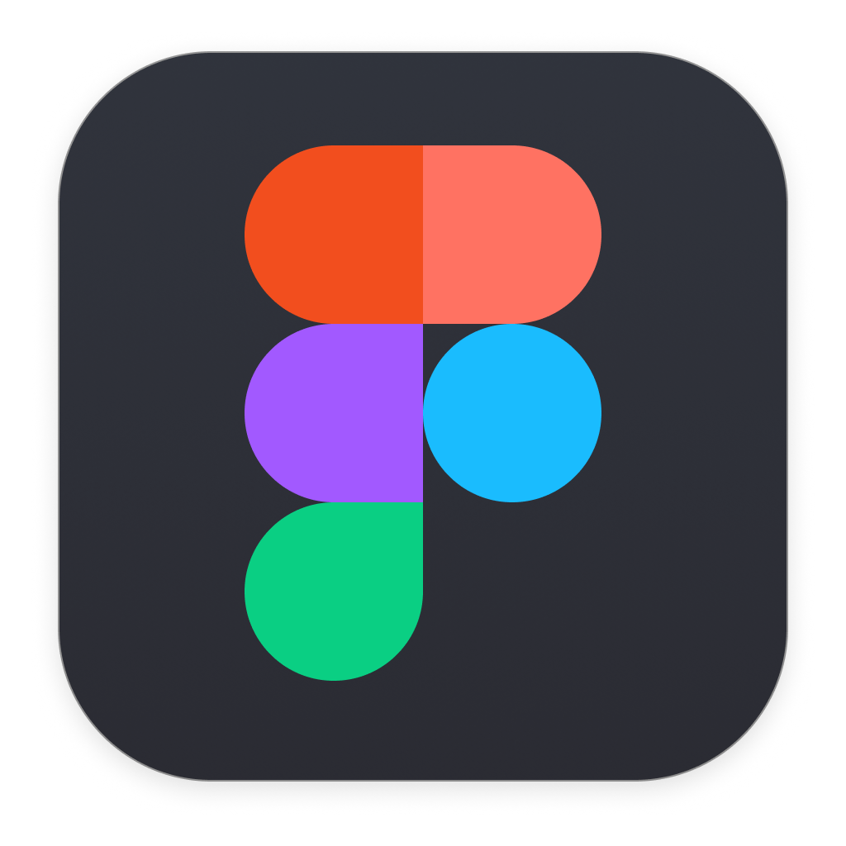


Tools
Visual Studio Code
Spring Tool Suite
GitHub
Figma
Draw.io
Google Docs

Slide 8
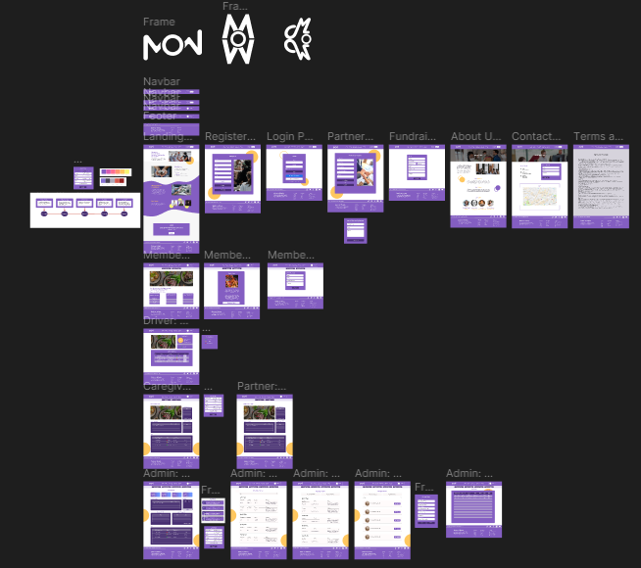
Project Design
https://www.figma.com/file/88hzqaiTxuBNj3s01aqCR3/M11%3APrototype?node-id=0%3A1&t=NF4Uh3P1Cg6fN6QK-1

Slide 9
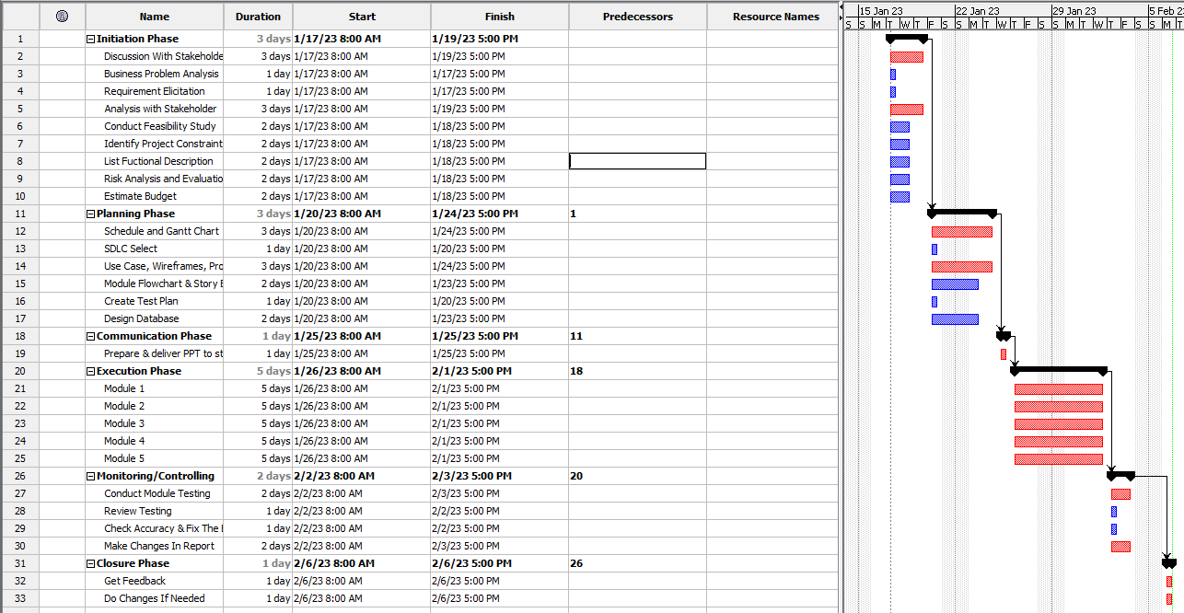
Project Gantt Chart

Slide 10
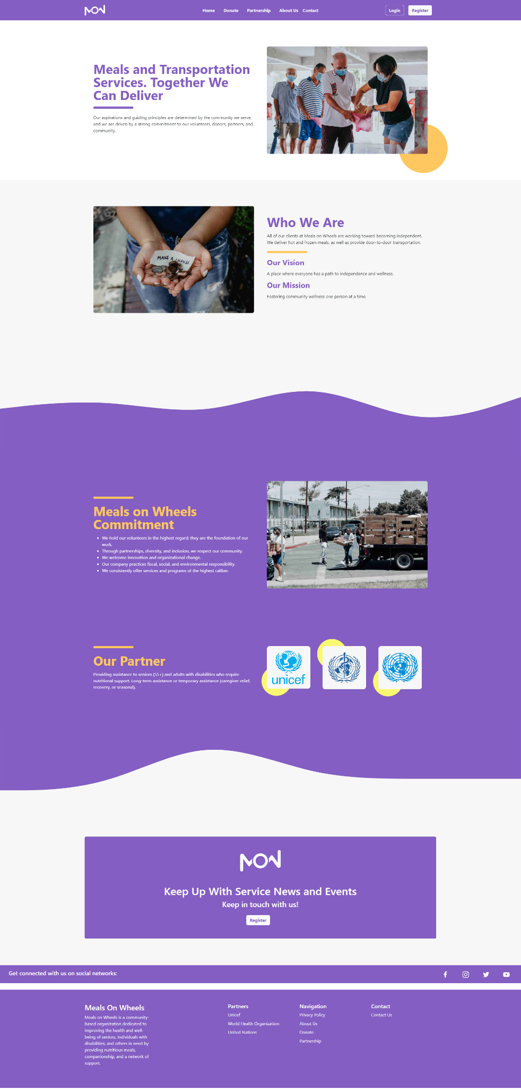
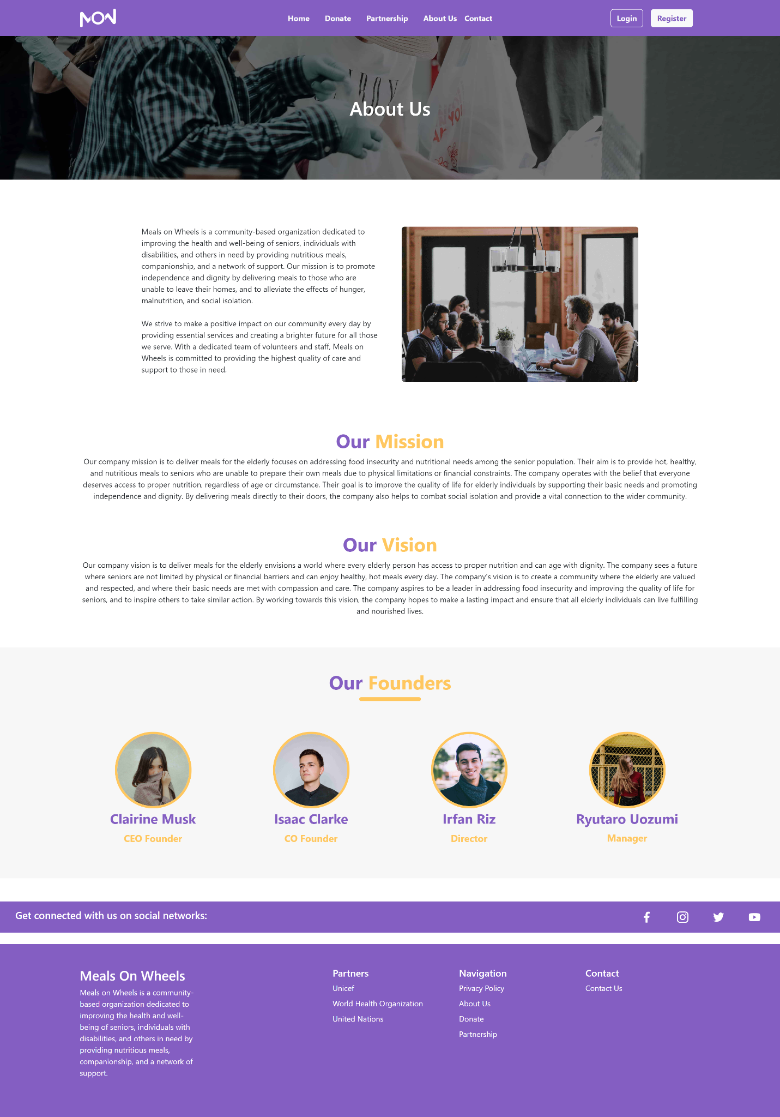
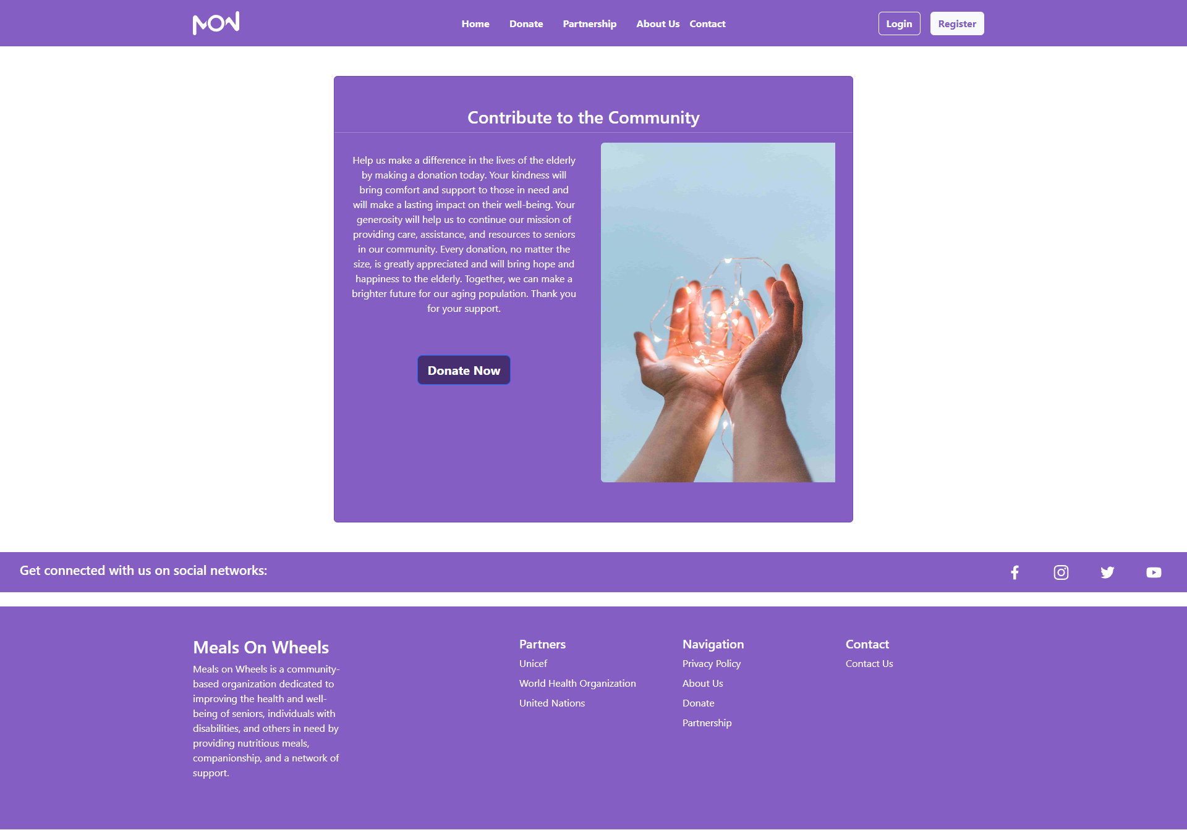
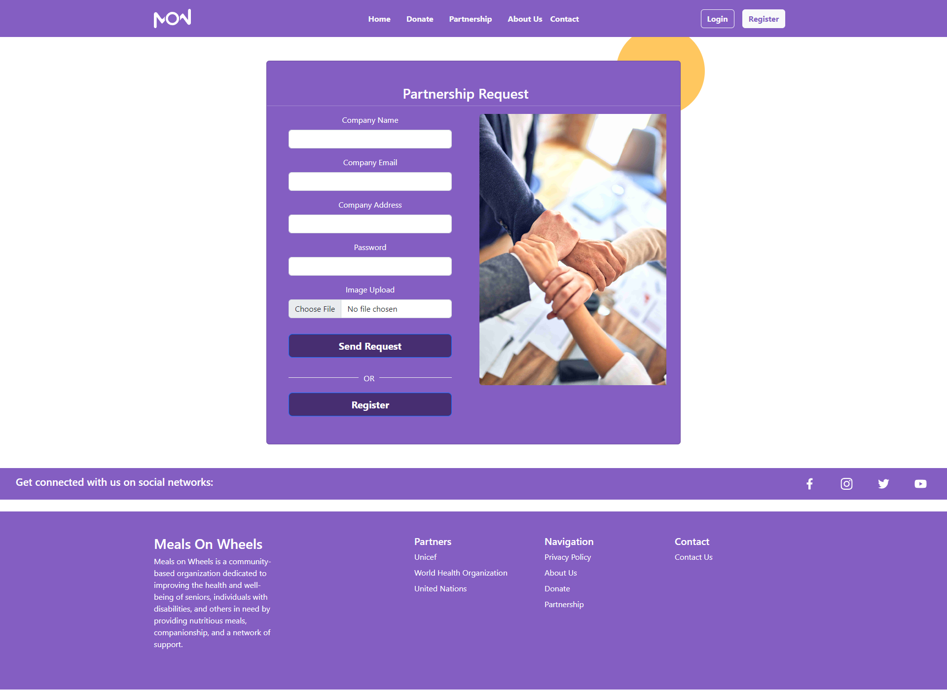
Project Execution
Home Page
About Us Page
Donate Page
Partnership Page

Slide 11
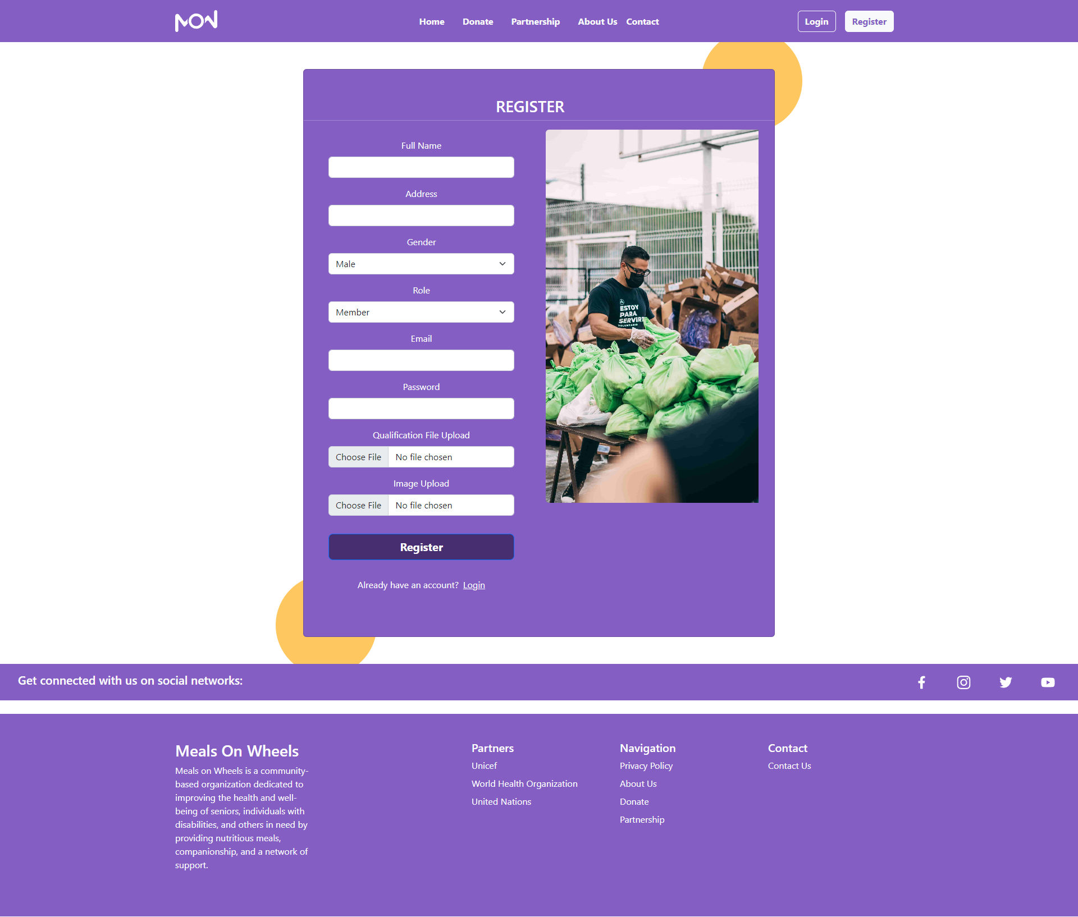
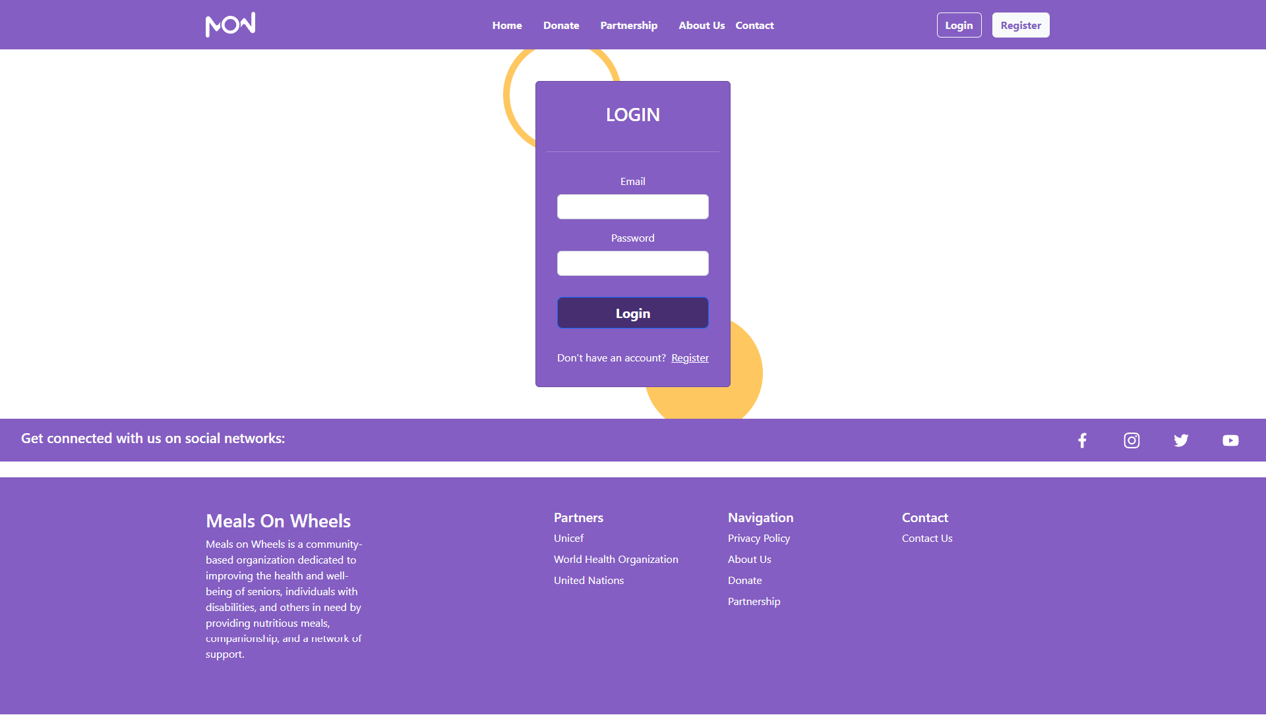
Project Execution
Register Page
Login Page

Slide 12
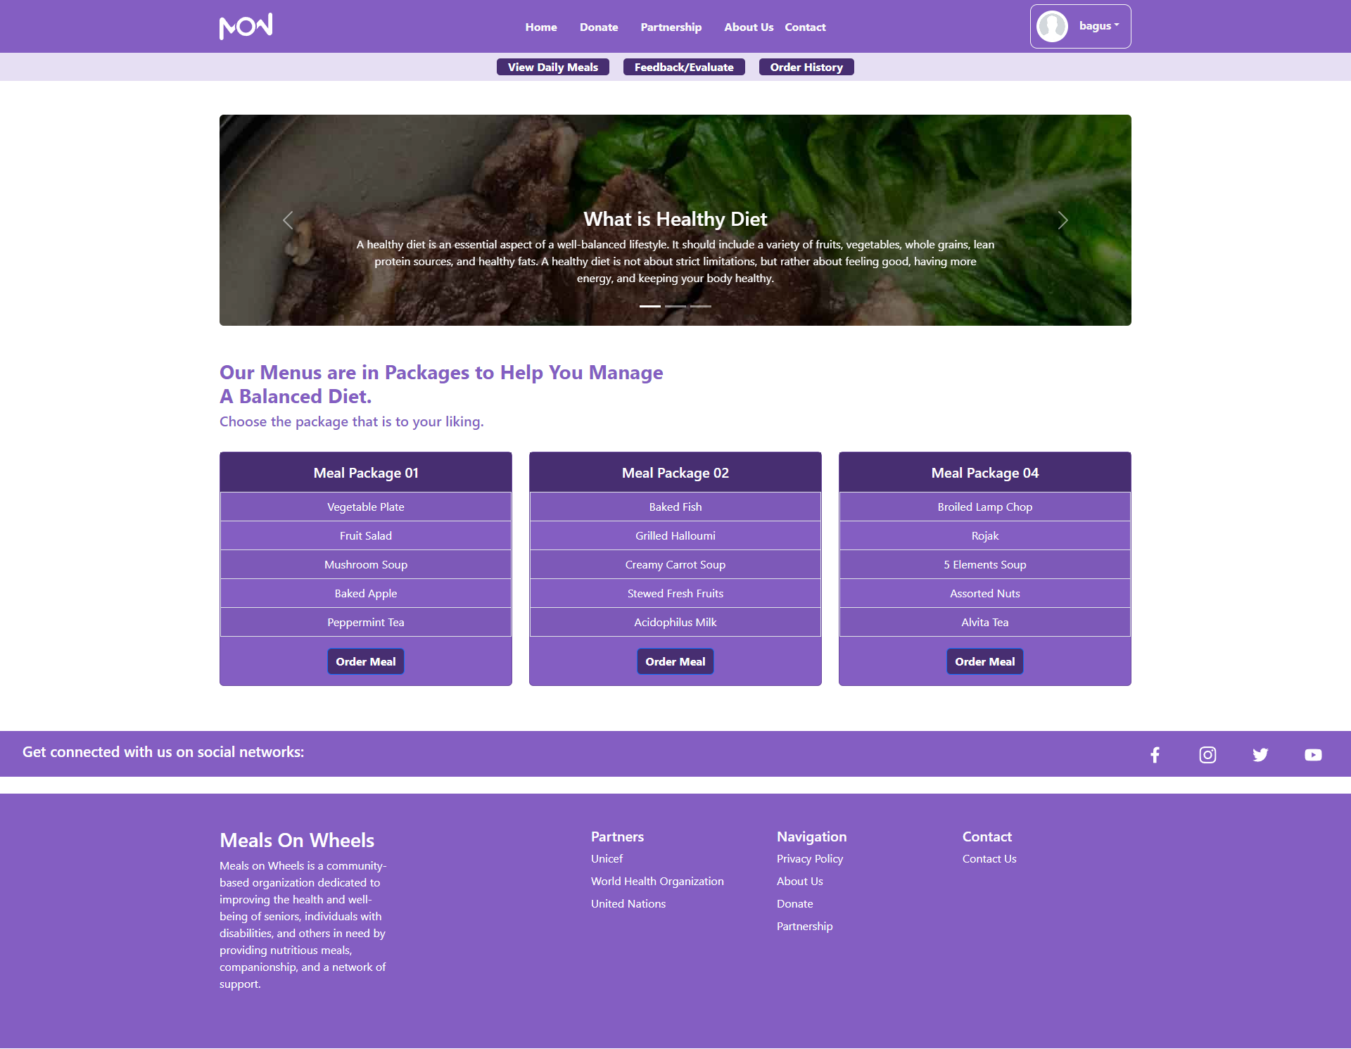
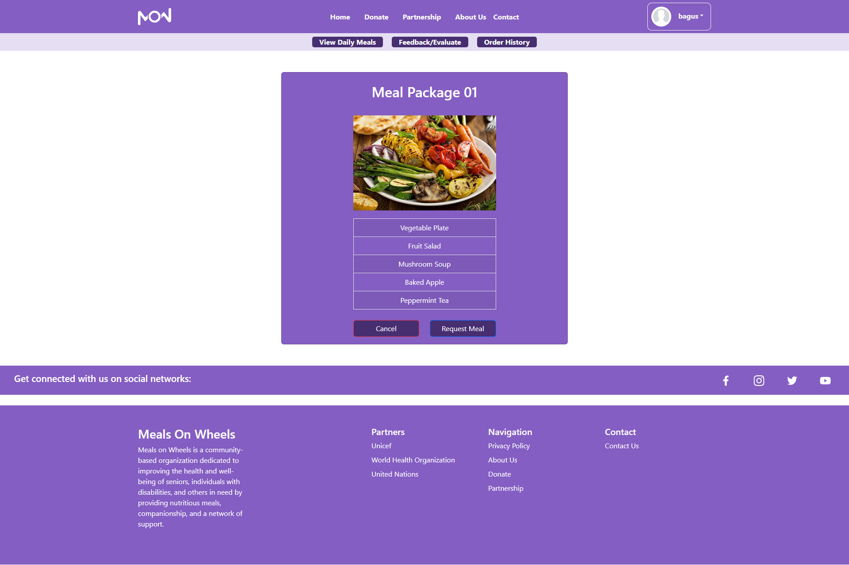
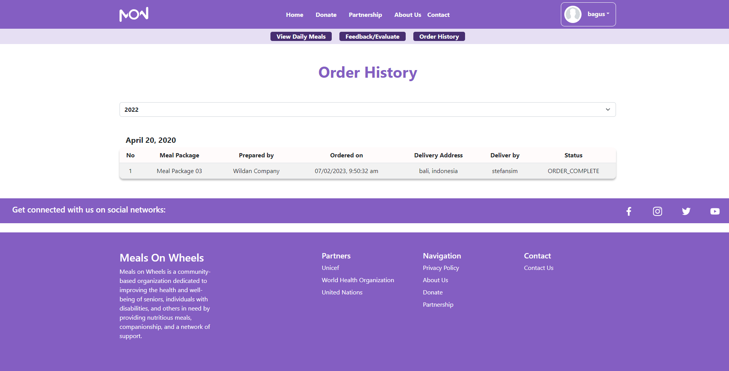
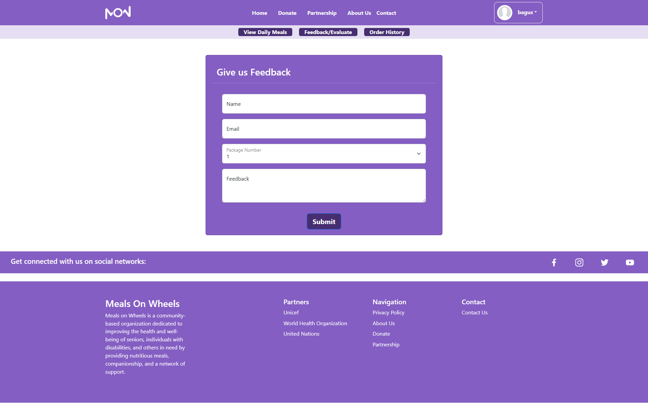
Project Execution
Member Home Page
Member Order Meal Page
Member Order History Page
Member Feedback Page

Slide 13
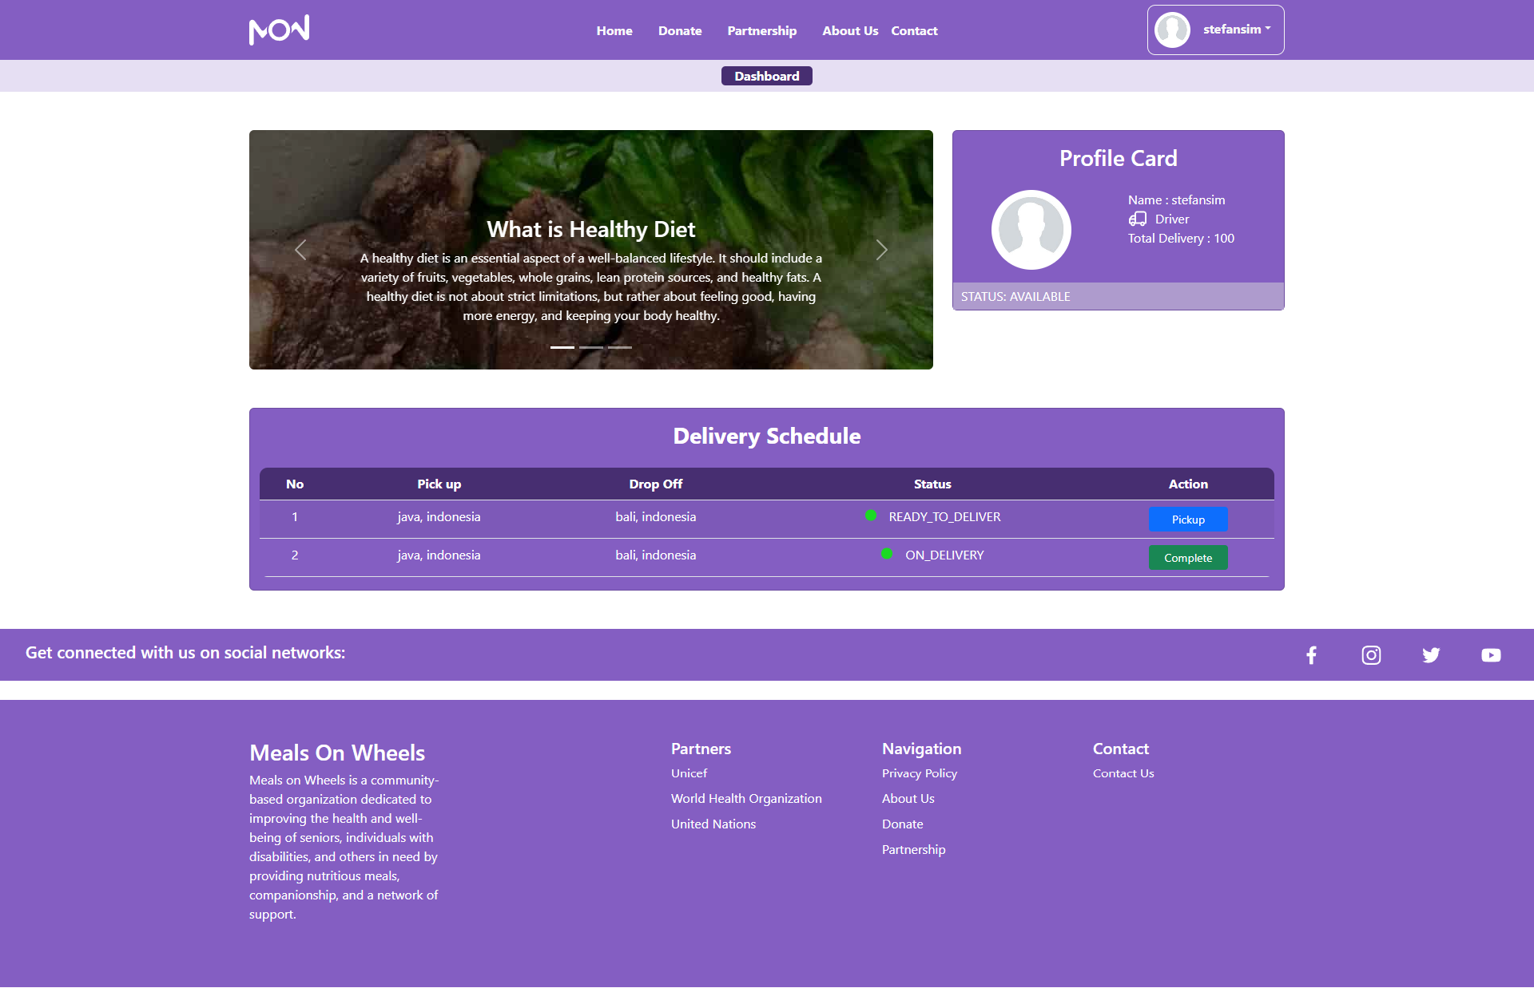
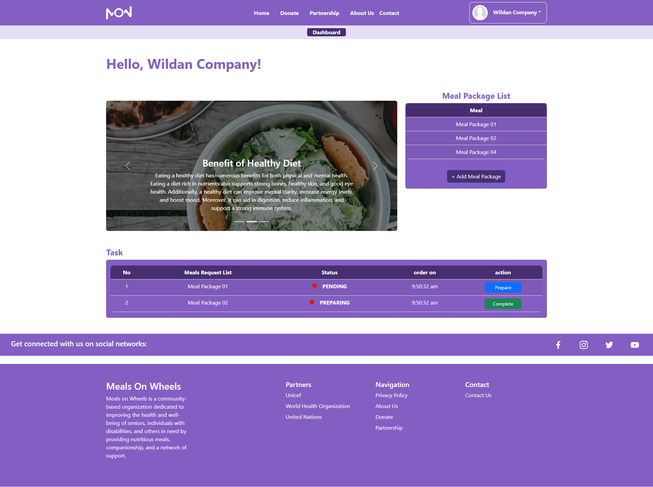
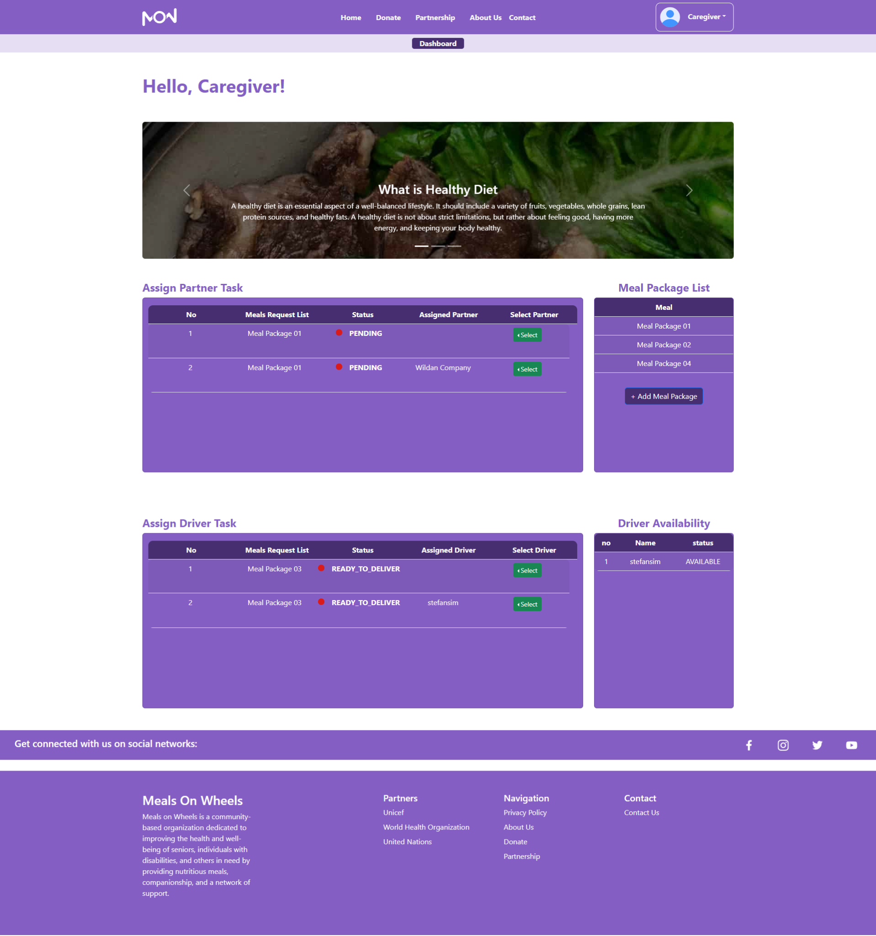
Project Execution
Driver Home Page
Partner Home Page
Caregiver Home Page

Slide 14
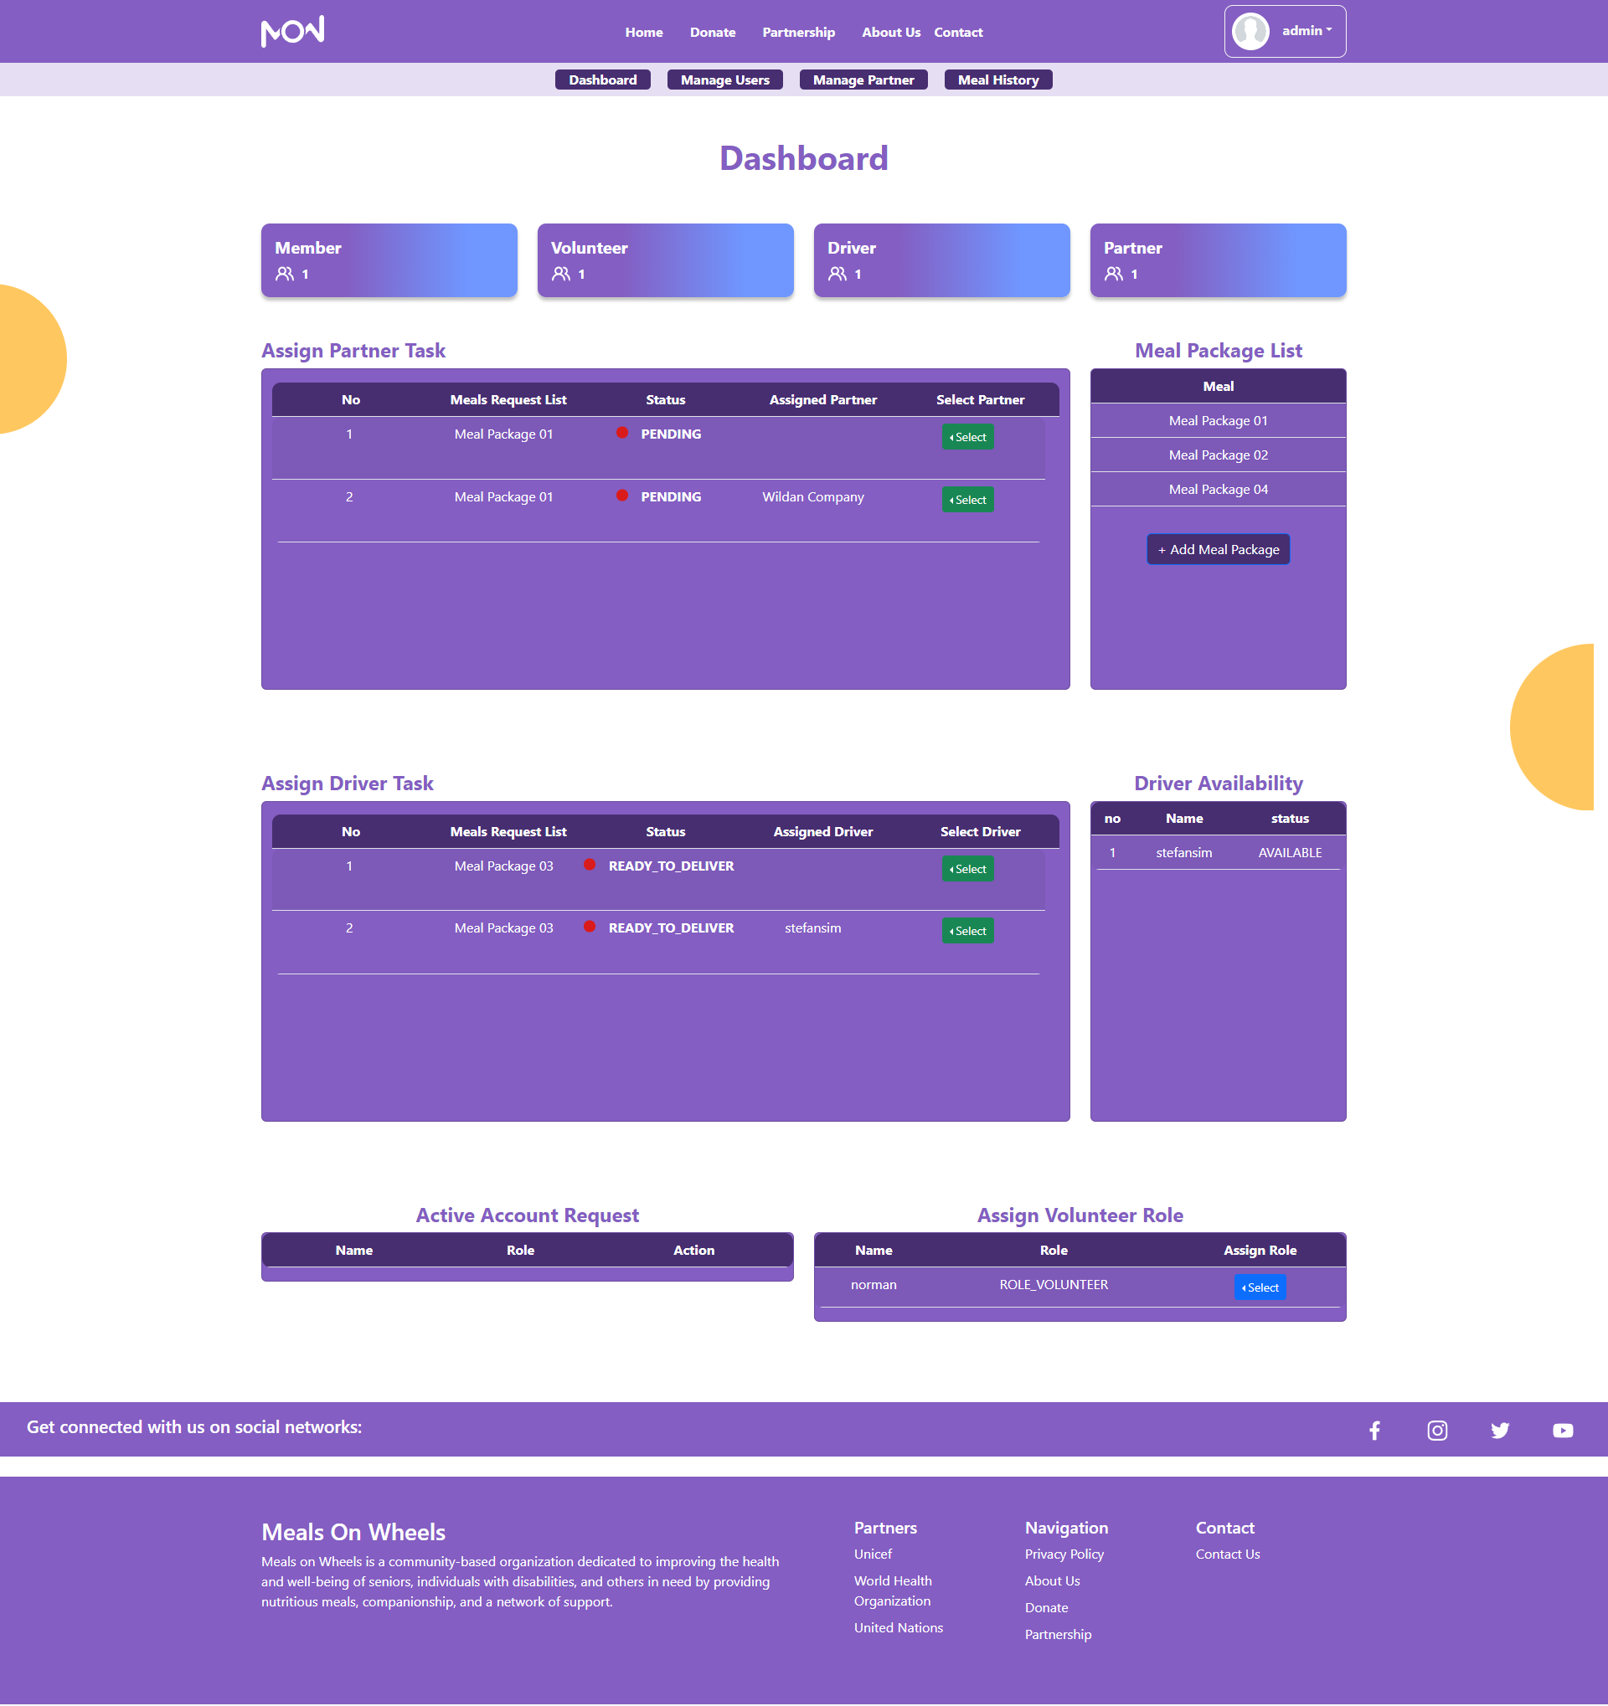
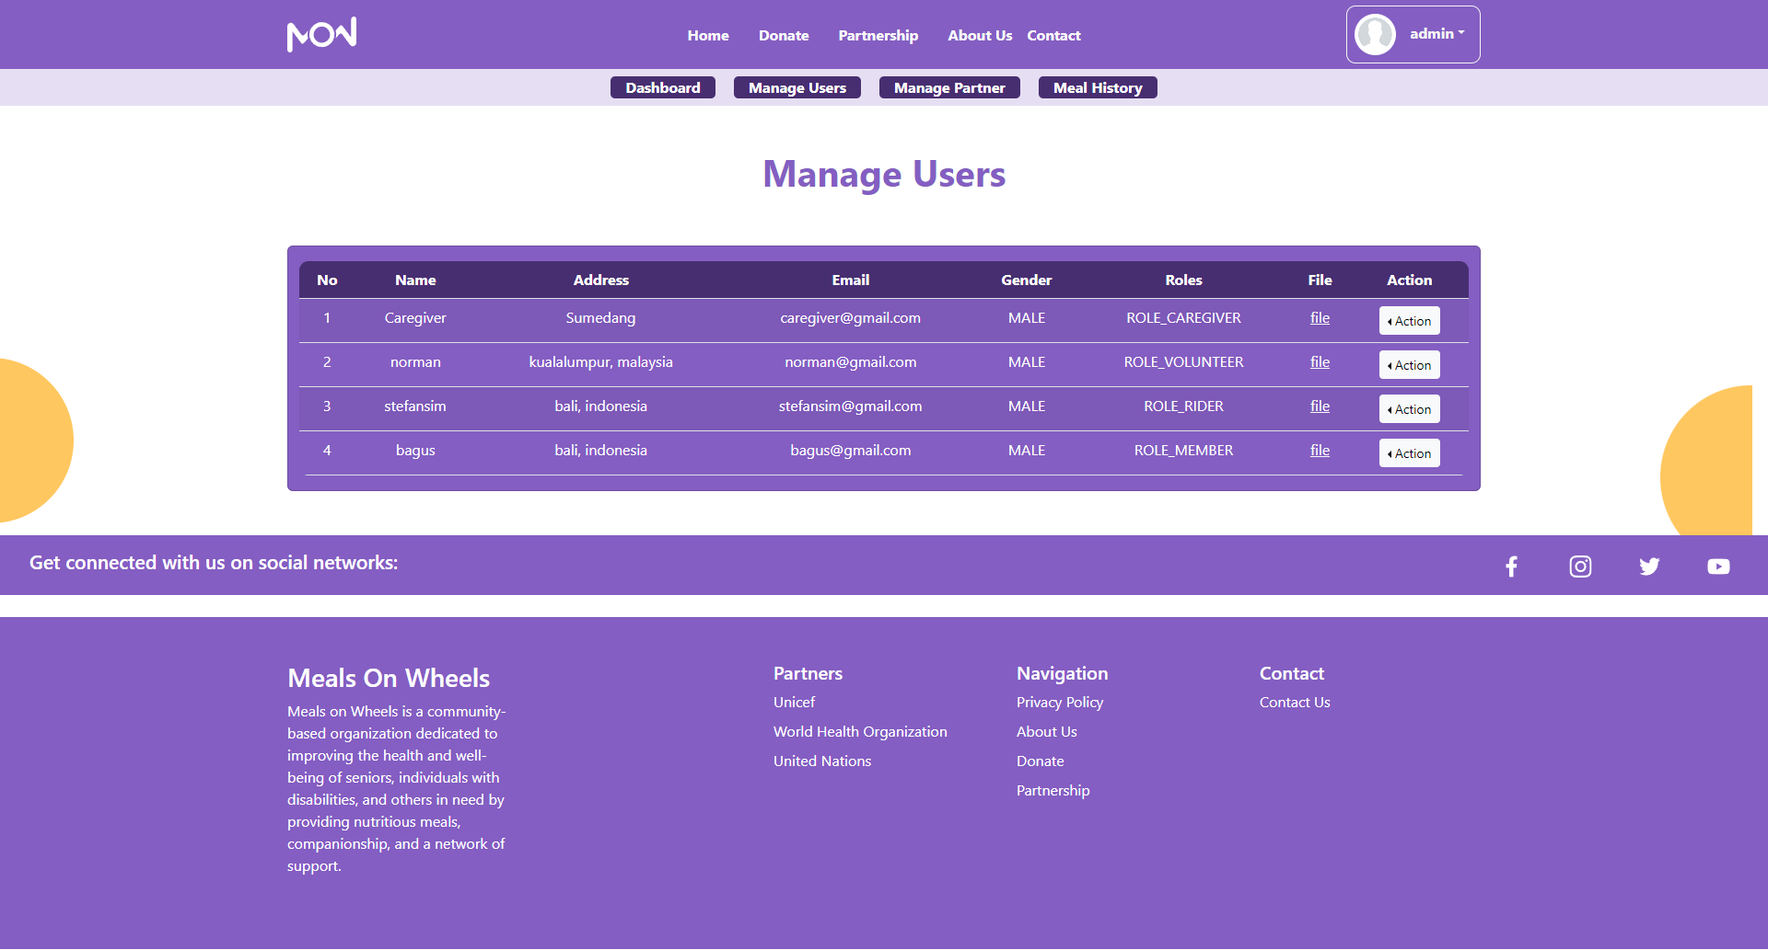
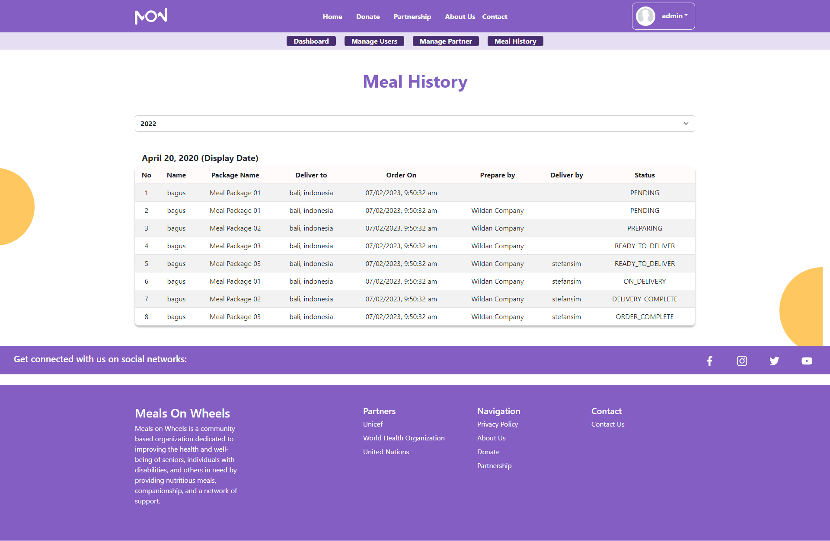
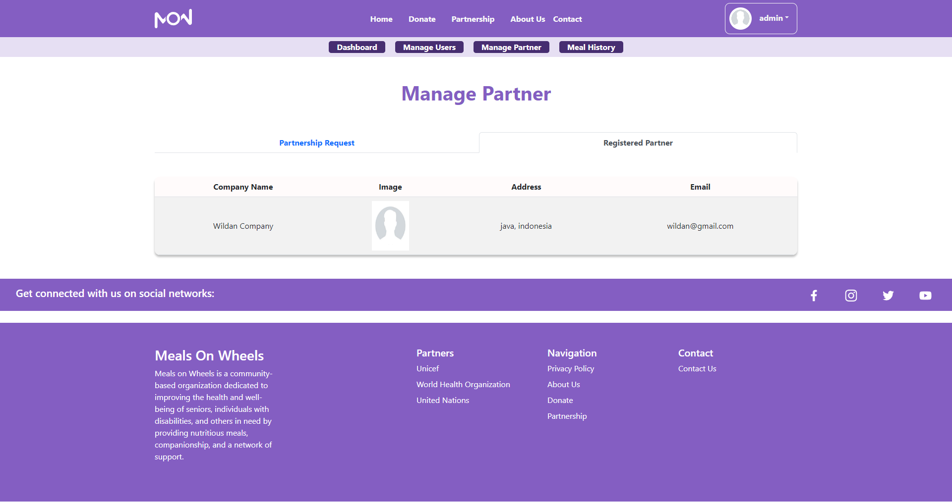
Project Execution
Admin Home Page
Admin Manage Users Page
Admin Meals History Page
Admin Manage Partner Page

Slide 15
Milestone Feedback & Action Taken
Project Milestone ID | Milestone Feedback received from Tutor / Learning Facilitator | Action Taken (Yes / No)
1 | Partner able to receive meal request from caregiver / admin | Yes
 | After they are done preparing the meal, they can input “complete” status so the caregiver/admin will then proceed to assign driver. | Yes
2
3

Slide 16
Proposed Improvements
Area of Improvements:
One who registered as a volunteer needs a set duration on how long they are going to volunteer (2 weeks or 1 month), since they are not full-time workers like caregivers or drivers.
Each user role on the website can’t edit their registered data, as a result they are unable to have a profile page and change the data on the website.
Need more polishing on the front-end design.
Future Recommendations:
Add Food Safety Management System
Add Order Notification for Caregiver, Partner, & Admin.
Add chat functionality for the member to chat with the caregiver or admin directly & instantly.

Slide 17
Thank You

